Slide 1

Design Patterns
SoftUni Team
Technical Trainers
Software University
https://softuni.bg

Slide 2
Table of Contents
Definition of Design Patterns
Benefits and Drawbacks
Types of Design Patterns
Creational
Structural
Behavioral

Slide 3
Have a Question?
sli.do
#java-advanced

Slide 4

Design Patterns

Slide 5
What Are Design Patterns?
General and reusable solutions to common problems in software design
A template for solving given problems
Add additional layers of abstraction in order to reach flexibility
5

Slide 6
What Do Design Patterns Solve?
Patterns solve software structural problems like:
Abstraction
Encapsulation
Separation of concerns
Coupling and cohesion
Separation of interface and implementation
Divide and conquer
6

Slide 7
Elements of a Design Pattern
Pattern name - Increases vocabulary of designers
Problem - Intent, context, and when to apply
Solution - Abstract code
Consequences - Results and trade-offs
7

Slide 8

Why Design Patterns?

Slide 9

Benefits
Names form a common vocabulary
Enable large-scale reuse of software architectures
Help improve developer communication
Help ease the transition to Object-Oriented technology
Can speed-up the development
9

Slide 10

Drawbacks
Do not lead to a direct code reuse
Deceptively simple
Developers may suffer from pattern overload and overdesign
Validated by experience and discussion, not by automated testing
Should be used only of understood well
10

Slide 11



Types of Design Patterns

Slide 12
Main Types
Creational patterns
Deal with initialization and configuration of classes and objects
Structural patterns
Describe ways to assemble objects to implement new functionality
Composition of classes and objects
Behavioral patterns
Deal with dynamic interactions among societies of classes
Distribute responsibility
12

Slide 13

Creational Patterns

Slide 14
Purposes
Deal with object creation mechanisms
Trying to create objects in a manner suitable to the situation
Two main ideas
Encapsulating knowledge about which classes the system uses
Hiding how instances of these classes are created
14

Slide 15
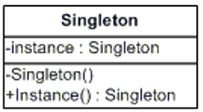
Singleton Pattern
The most often used creational design pattern
A Singleton class is supposed to have only one instance
It is not a global variable
Possible problems
Lazy loading
Thread-safe

Slide 16
Double-Check Singleton Example
class SerializableSingleton implements Serializable {
private static SerializableSingleton instance;
private SerializableSingleton() {}
public static synchronized SerializableSingleton getInstance() {
if(instance == null) {
instance = new SerializableSingleton();
}
return instance;
}
}
16

Slide 17
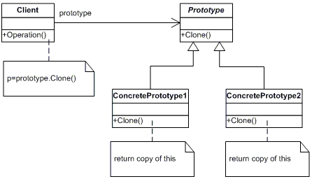
Prototype Pattern
Factory for cloning new instances from a prototype
Create new objects by copying this prototype
Instead of using the "new" keyword
The cloneable interface acts as Prototype

Slide 18
The Prototype Abstract Class
public abstract class Prototype {
private String id;
public Prototype(String id) {
this.id = id; }
public String getId() { return this.id; }
public abstract Prototype clone();
}
18

Slide 19
A Concrete Prototype Class
class ConcretePrototype extends Prototype {
public ConcretePrototype(string id) {
super(id);
}
@Override
public Prototype clone() {
return (Prototype)this.clone(); }
}
19

Slide 20
Builder Pattern
Separates the construction of a complex object from its representation
The same construction process can create different representations
Provides control over steps of the construction process

Slide 21
Example: Computer Class
public class Computer {
private String RAM;
private boolean isGraphicsCardEnabled;
public String getRAM() { return RAM; }
public boolean isGraphicsCardEnabled() {
return isGraphicsCardEnabled;
}
public Computer(String ram, boolean isGraphicsCardEnabled) {
this.RAM = ram;
this.isGraphicsCardEnabled = isGraphicsCardEnabled;
}
}
21

Slide 22
Example: ComputerBuilder Class
public class ComputerBuilder {
private String RAM;
private boolean isGraphicsCardEnabled;
public ComputerBuilder(String ram){ this.RAM = ram; }
public ComputerBuilder setGraphicsCardEnabled(
boolean isGraphicsCardEnabled) {
this.isGraphicsCardEnabled = isGraphicsCardEnabled;
return this; }
public Computer build(){
return new Computer(this.RAM, this.isGraphicsCardEnabled);
} }
22

Slide 23

Structural Patterns

Slide 24
Purposes
Describe ways to assemble objects to implement a new functionality
Ease the design by identifying a simple way to realize the relationship between entities
All about Class and Object composition
Inheritance to compose interfaces
Ways to compose objects to obtain new functionality
24

Slide 25
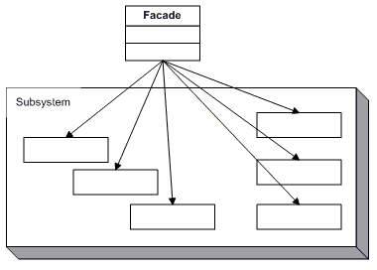
Façade Pattern
Provides a unified interface to a set of interfaces in a subsystem
Defines a higher-level interface that makes the subsystem easier to use

Slide 26
The Façade Class (1)
class Facade {
private SubSystemOne one;
private SubSystemTwo two;
public Facade() {
one = new SubSystemOne();
two = new SubSystemTwo();
}
26

Slide 27
The Façade Class (2)
public void MethodA() {
System.out.println("\nMethodA() ---- ");
one.MethodOne();
two.MethodTwo(); }
public void MethodB() {
System.out.println("\nMethodB() ---- ");
two.MethodTwo(); }
}
27

Slide 28
Subsystem Classes
class SubSystemOne {
public void MethodOne() {
System.out.println(" SubSystemOne Method"); }
}
class SubSystemTwo {
public void MethodTwo() {
System.out.println(" SubSystemTwo Method"); }
}
28

Slide 29
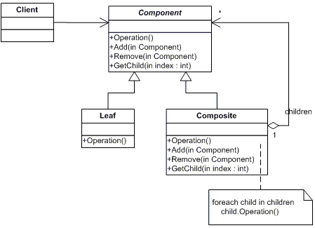
Composite Pattern
Allows to combine different types of objects in tree structures
Gives the possibility to treat the same object(s)
Used when
You have different objects that you want to treat the same way
You want to present a hierarchy of objects

Slide 30
The Component Abstract Class
abstract class Component {
protected String name;
public Component(String name) {
this.name = name; }
public abstract void add(Component c);
public abstract void remove(Component c);
public abstract void display(int depth);
}
30

Slide 31
The Composite Class (1)
class Composite extends Component {
private List<Component> children = new ArrayList<Component>();
public Composite(String name) { super(name); }
@Override
public void add(Component component) {
children.add(component); }
@Override
public void remove(Component component) {
children.Remove(component); }
31

Slide 32
The Composite Class (2)
@Override
public void display(int depth) {
System.out.println(printNameInDepth(depth, name);
foreach (Component component : children) {
component.display(depth + 2);
}
}
public void printNameInDepth(int depth, String name) {
for(int i = 0; i < depth; i++)
System.out.print("-");
System.out.print(name);
}
32

Slide 33
The Leaf Class
class Leaf extends Component {
public Leaf(String name) { super(name); }
@Override
public void add(Component c) {
System.out.println("Cannot add to a leaf"); }
@Override
public void Remove(Component c) {
System.out.println("Cannot remove from a leaf"); }
@Override
public void Display(int depth) {
System.out.println(printNameInDepth(depth, name); }
}
33

Slide 34

Behavioral Patterns

Slide 35
Purposes
Concerned with the interaction between objects
Either with the assignment of responsibilities between objects
Or encapsulating behavior in an object and delegating requests to it
Increases flexibility in carrying out cross-classes communication
35

Slide 36
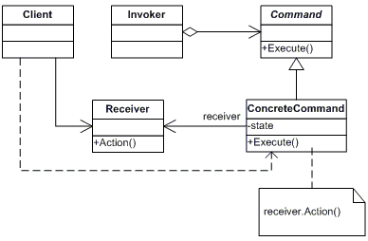
Command Pattern
An object encapsulates all the information needed to call a method at a later time
Lets you parameterize clients with different requests, queue or log requests, and support undoable operations

Slide 37
The Command Abstract Class
abstract class Command {
protected Receiver receiver;
public Command(Receiver receiver) {
this.receiver = receiver; }
public abstract void execute();
}
37

Slide 38
Concrete Command Class
class ConcreteCommand extends Command {
public ConcreteCommand(Receiver receiver) {
super(receiver); }
@Override
public void execute() {
receiver.action(); }
}
38

Slide 39
The Receiver Class
class Receiver {
public void action() {
System.out.println("Called Receiver.action()");
}
}
39

Slide 40
The Invoker Class
class Invoker {
private Command command;
public void setCommand(Command command) {
this.command = command; }
public void ExecuteCommand() {
command.execute(); }
}
40

Slide 41
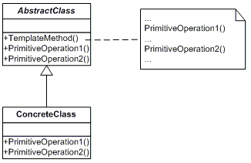
Template Pattern
Define the skeleton of an algorithm in a method, leaving some implementation to its subclasses
Allows the subclasses to redefine the implementation of some of the parts of the algorithm, but not its structure

Slide 42
The Abstract Class
abstract class AbstractClass {
public abstract void primitiveOperation1();
public abstract void primitiveOperation2();
public void templateMethod() {
primitiveOperation1();
primitiveOperation2();
System.out.println(""); }
}
42

Slide 43
A Concrete Class
class ConcreteClassA extends AbstractClass {
@Override
public void primitiveOperation1() {
System.out.println("ConcreteClassA.primitiveOperation1()"); }
@Override
public void primitiveOperation2() {
System.out.println("ConcreteClassA.primitiveOperation2()");
}
43

Slide 44

Summary
…
…
…
Design Patterns
Provide solution to common problems
Add additional layers of abstraction
Three main types of Design Patterns
Creational
Structural
Behavioral

Slide 45
Questions?
Notes:
45

Slide 46













SoftUni Diamond Partners

Slide 47


Educational Partners

Slide 48
Trainings @ Software University (SoftUni)
Software University – High-Quality Education, Profession and Job for Software Developers
softuni.bg
Software University Foundation
softuni.foundation
Software University @ Facebook
facebook.com/SoftwareUniversity
Software University Forums
forum.softuni.bg
48
Notes:
48

Slide 49

License
This course (slides, examples, demos, exercises, homework, documents, videos and other assets) is copyrighted content
Unauthorized copy, reproduction or use is illegal
© SoftUni – https://about.softuni.bg
© Software University – https://softuni.bg
Notes:
49

